Slide 1
Chapter 1
Introduction to e-business and e-commerce
Notes:
‹#›

Slide 2
What is e-commerce and e-business?
E-commerce :
All electronically mediated information exchange between an organization and its external stakeholders (Chaffey)
Digitally enabled commercial transactions between and among organizations and individuals
Notes:
‹#›

Slide 3
What is e-commerce and e-business?
E-business:
All electronically mediated information exchanges, both within an organization and with external stakeholders supporting the range of business process (Chaffey)
Digital enablement of transactions and processes within a firm, involving information systems under firm’s control. Does not include commercial transactions involving an exchange of value across organizational boundaries (Laudon)
Notes:
‹#›

Slide 4
E-Business concepts
E-business defined from the following perspectives:
Communications: delivery of goods, services, information, or payments over computer networks or any other electronic means
Commercial (trading): provides capability of buying and selling products, services, and information on the Internet and via other online services

Slide 5
E-Business concepts (cont.)
Business process: doing business electronically by completing business processes over electronic networks, thereby substituting information for physical business processes
Service: a tool that addresses the desire of governments, firms, consumers, and management to cut service costs while improving the quality of customer service and increasing the speed of service delivery

Slide 6
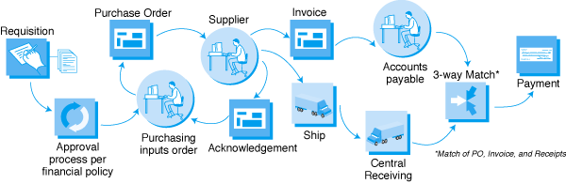
Traditional Purchasing Process Flow
Source: ariba.com, February 2001.

Slide 7
E-Business concepts (cont.)
Learning: an enabler of online training and education in schools, universities, and other organizations, including businesses
Collaborative: the framework for inter- and intra-organizational collaboration
Community: provides a gathering place for community members to learn, transact, and collaborate

Slide 8
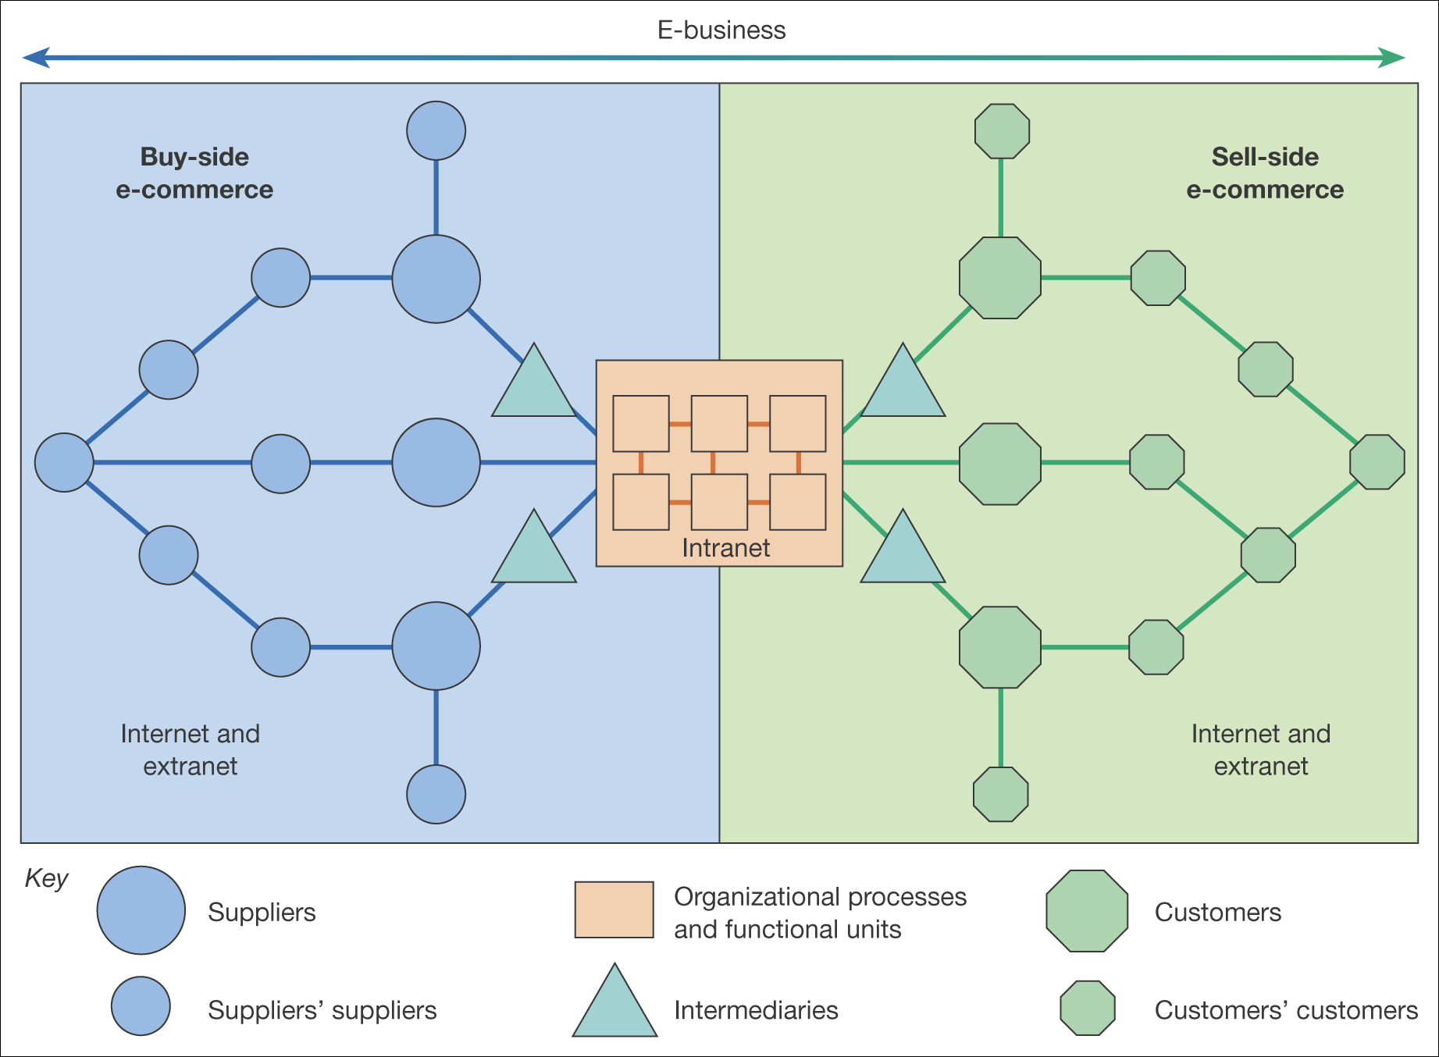
Figure 1.2 The distinction between buy-side and sell-side e-commerce
Notes:
‹#›

Slide 9
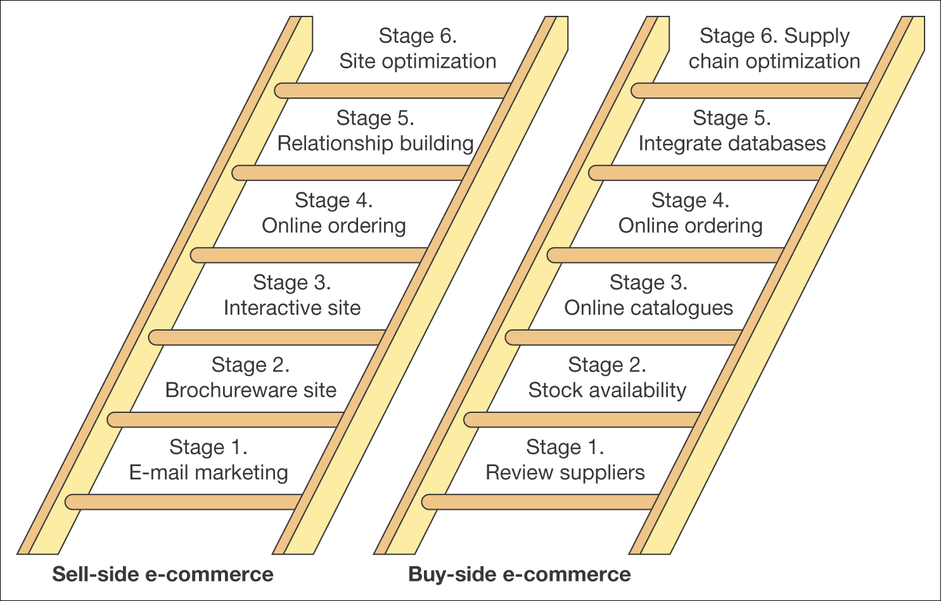
Figure 1.13 A simple stage model for buy-side and sell-side e-commerce
Notes:
‹#›

Slide 10
Buy-side e-commerce – refers to transactions to procure resources needed by an organization from its suppliers.
Sell-side e-commerce refers to transactions involved with selling products to an organization’s customers.
Notes:
‹#›

Slide 11
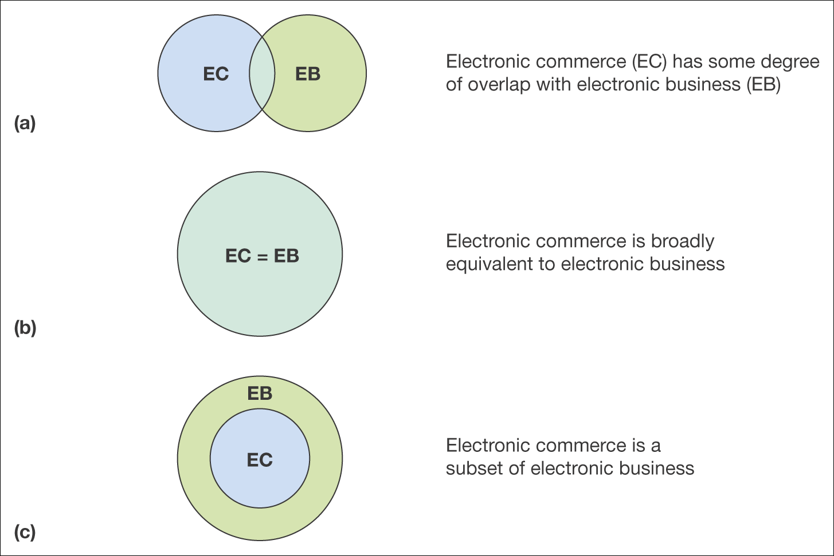
Figure 1.3 Three definitions of the relationship between e-commerce and e-business
Notes:
‹#›

Slide 12
Intranet vs. Extranet
Notes:
‹#›

Slide 13
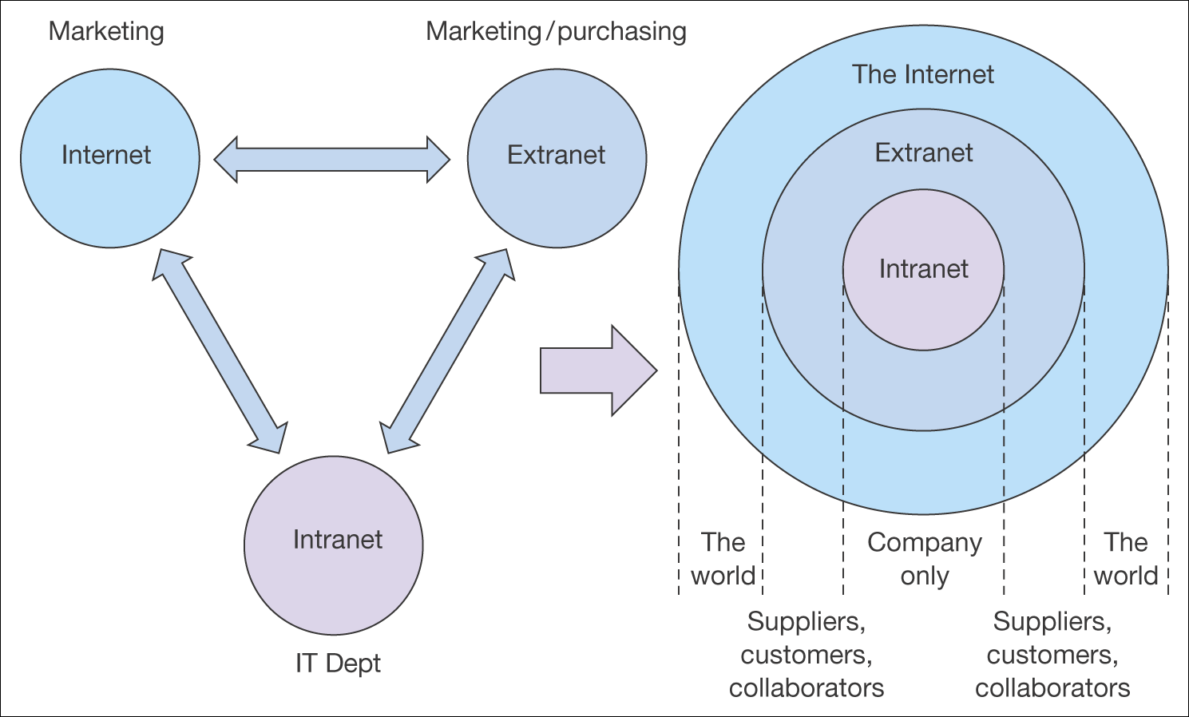
Figure 1.4 The relationship between intranets, extranets and the Internet
Notes:
‹#›

Slide 14
Why Study E-commerce?
E-commerce technology is different, more powerful than previous technologies
E-commerce bringing fundamental changes to commerce
Traditional commerce:
Passive consumer
Sales-force driven
Fixed prices
Information asymmetry

Slide 15
Unique Features of E-commerce Technology
Ubiquity
Global reach
Universal standards
Information richness
Interactivity
Information density
Personalization/customization
Social technology

Slide 16
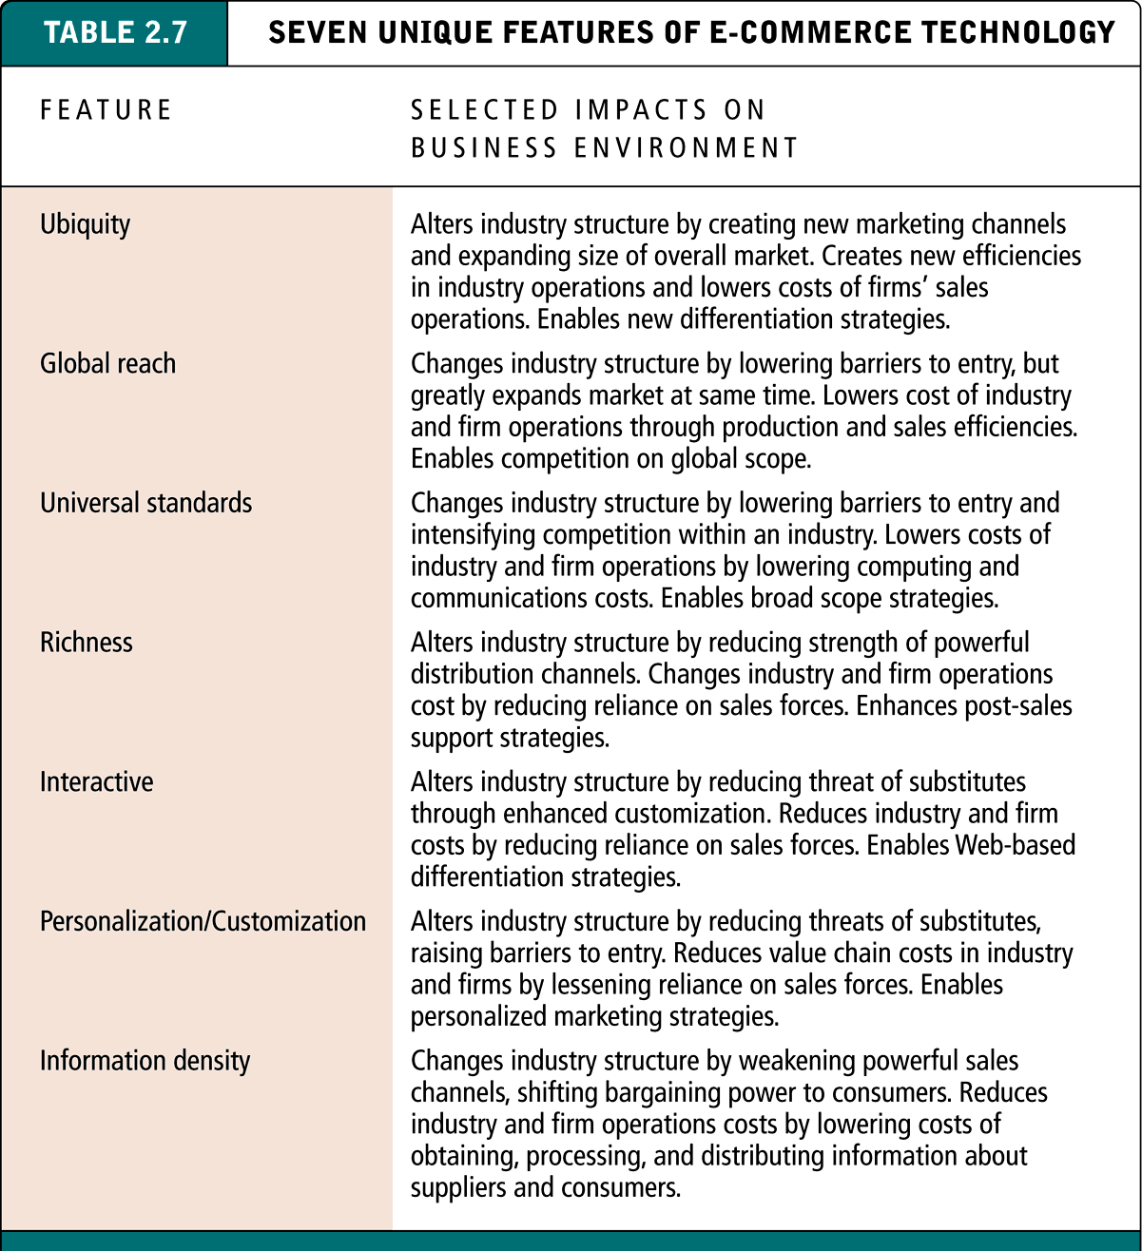
Seven Unique Features of E-commerce Technology

Slide 17
Types of E-commerce
Selling Side
Transaction e-commerce sites
Service-oriented relationship-building site
Brand-building sites
Portal, publisher or media sites

Slide 18
e-Commerce and SCM
What’s Supply Chain Management (SCM)
The coordination of all supply activities of an organization from its supplier and partners to its customers
Value Chain
How e-Commerce impact SCM?

Slide 19
Business-Consumer Model of e-Commerce
Classified by market relationship
Business-to-Consumer (B2C)
Business-to-Business (B2B)
Consumer-to-Consumer (C2C)
Classified by technology used
Peer-to-Peer (P2P), e.g., BitTorrent and Napster
Mobile commerce (M-commerce)

Slide 20
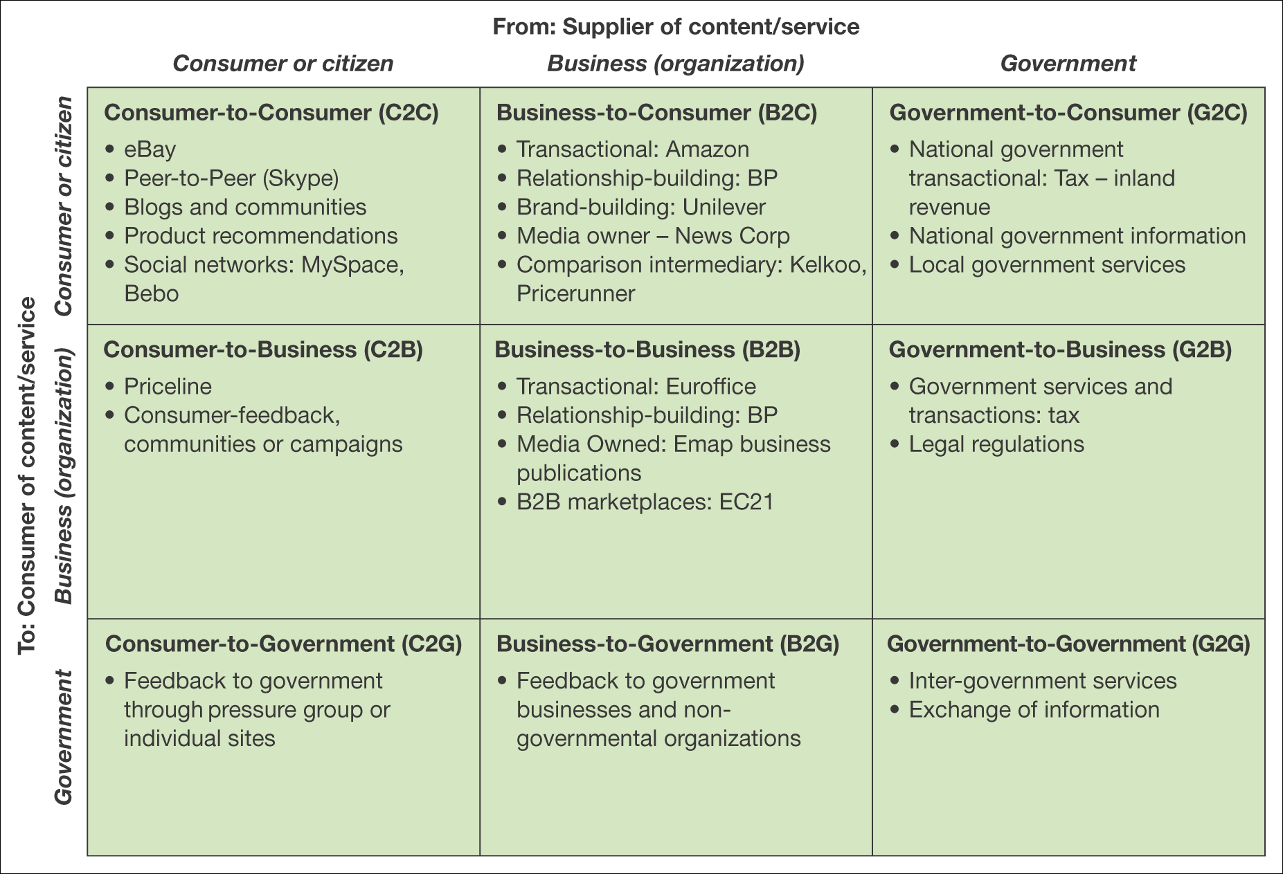
Figure 1.8 Summary and examples of transaction alternatives between businesses, consumers and governmental organizations
Notes:
‹#›

Slide 21
Tangible and intangible benefits
Tangible benefits | Intangible benefits
● Increased sales from new sales leads giving rise to increased revenue from: – new customers, new markets – existing customers (repeat-selling) – existing customers (cross-selling).  Marketing cost reductions from: – reduced time in customer service – online sales – reduced printing and distribution costs of marketing communications.  Supply-chain cost reductions from: – reduced levels of inventory – increased competition from suppliers – shorter cycle time in ordering.  Administrative cost reductions from more efficient routine business processes such as recruitment, invoice payment and holiday authorization. | ● Corporate image communication  Enhancement of brand  More rapid, more responsive marketing communications including PR  Faster product development lifecycle enabling faster response to market needs  Improved customer service  Learning for the future  Meeting customer expectations to have a web site  Identifying new partners, supporting existing partners better  Better management of marketing information and customer information  Feedback from customers on products

Slide 22
Figure 1.13 A simple stage model for buy-side and sell-side e-commerce
Notes:
‹#›

Slide 24
Cost/efficiency and competitiveness drivers
Cost/efficiency drivers
Increasing speed with which supplies can be obtained
Increasing speed with which goods can be dispatched
Reduced sales and purchasing costs
Reduced operating costs
Competitiveness drivers
Customer demand
Improving the range and quality of services offered
Avoid losing market share to businesses already using e-commerce
Notes:
‹#›

Slide 25
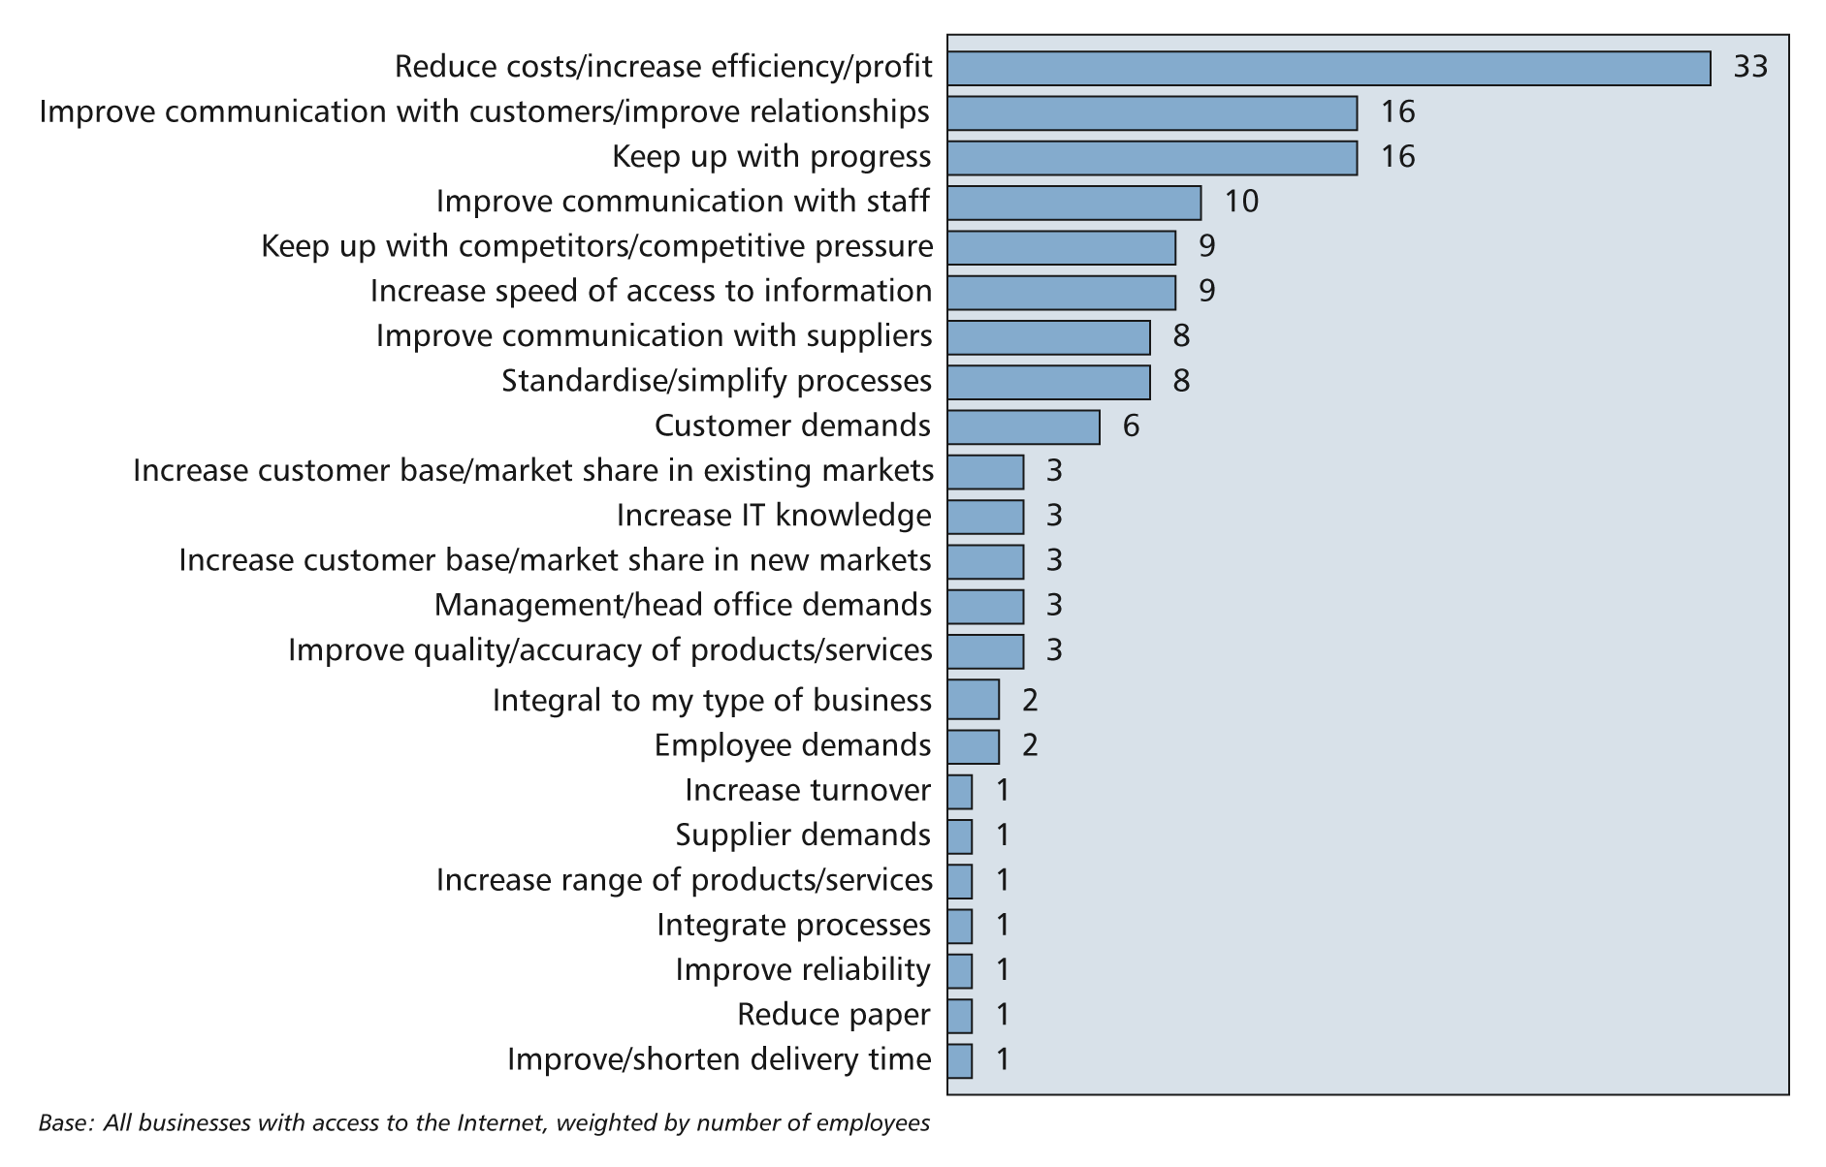
Drivers for e-commerce
Figure 1.6 Attitudes to benefits of online technologies
Source: DTI (2002)

Slide 26
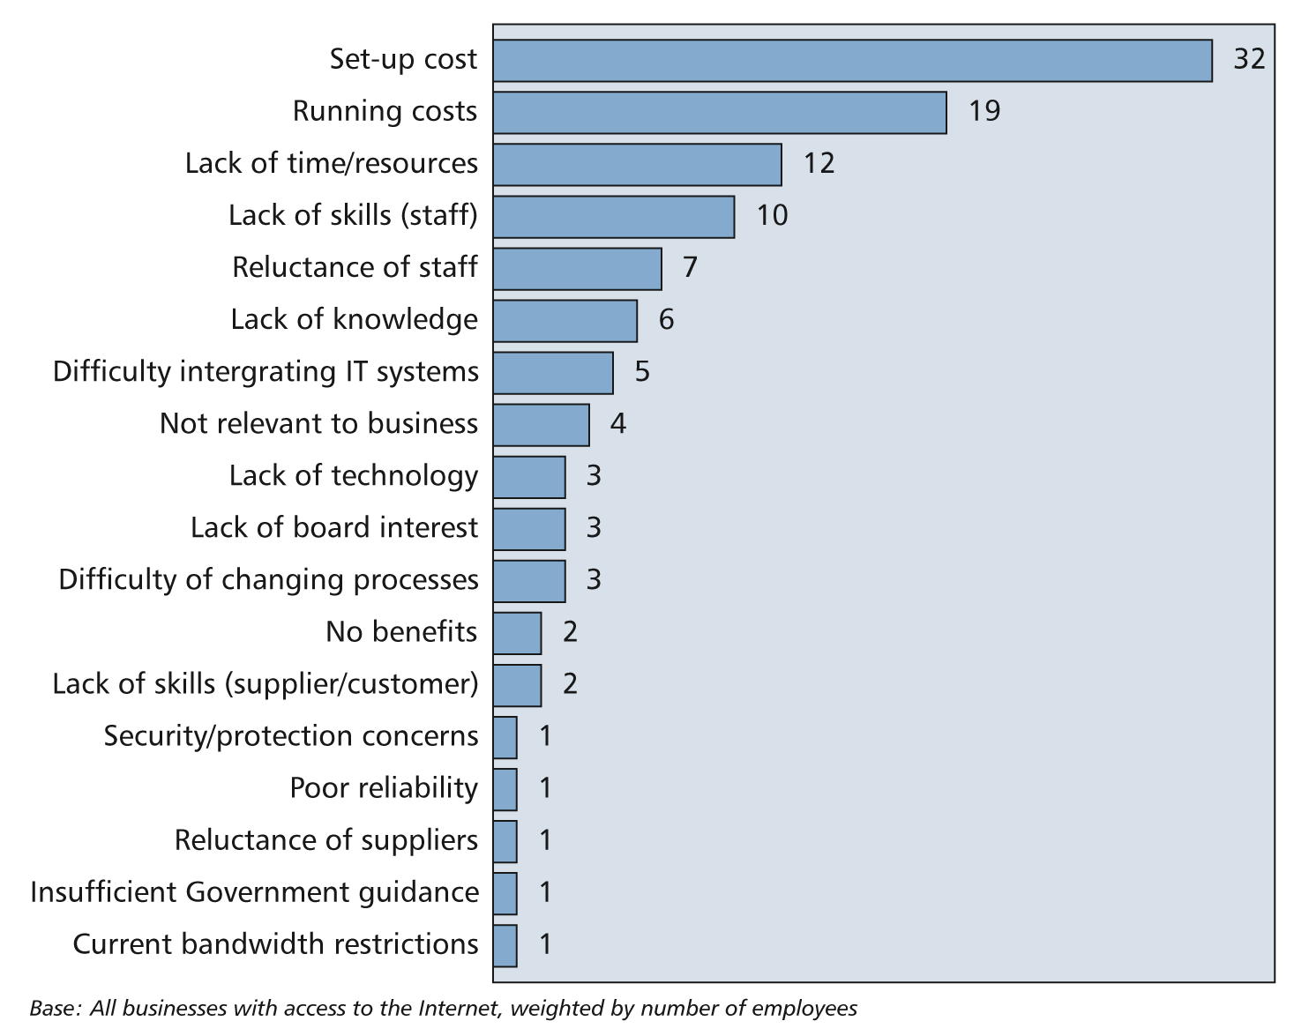
Barriers to e-commerce
Figure 1.7 Barriers to development of online technologies

Slide 27
Potential Limitations on B2C E-commerce*
Expensive technology
Sophisticated skill set
Persistent cultural attraction of physical markets and traditional shopping experiences
Persistent global inequality limiting access to telephones and computers
Saturation and ceiling effects

Slide 28
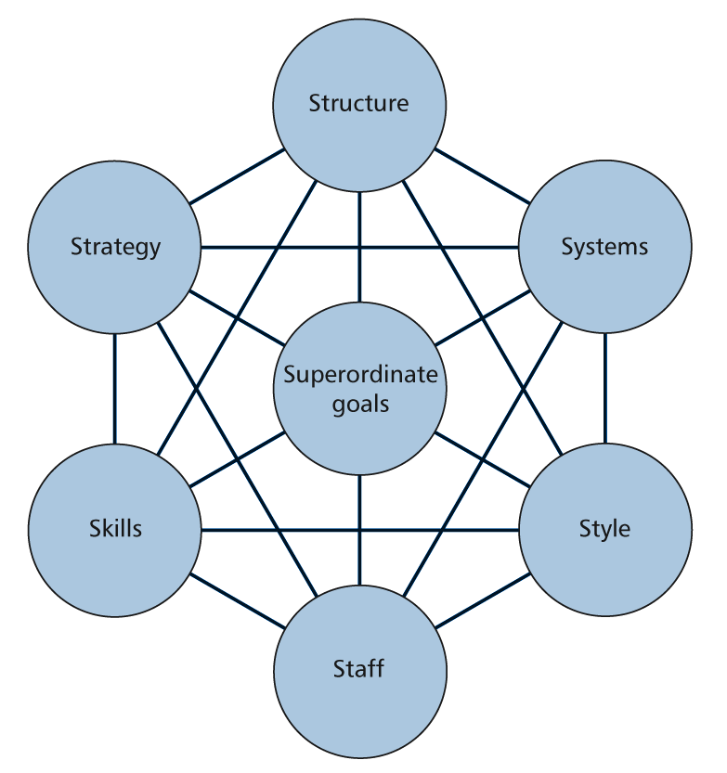
Answer – the McKinsey 7Ss framework

